Slide 1

React Native
A better mobile dev experience.

Slide 2
So you want to build an app?
How do you decide on a tech stack?
What platform are your users on?
What functionality do you require?
How often do you want to release?
What is your budget?
If you already have a team, what is their skillset?

Slide 3
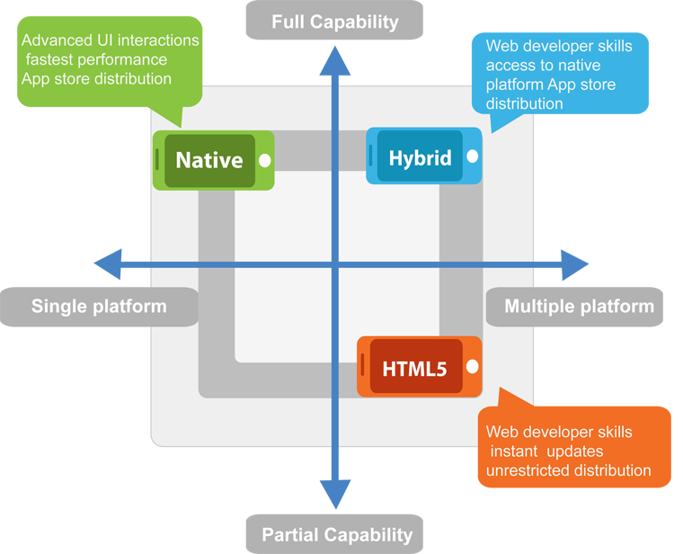
The Options
https://www.sphinx-solution.com/blog/what-you-should-choose-native-vs-cross-platform/

Slide 4
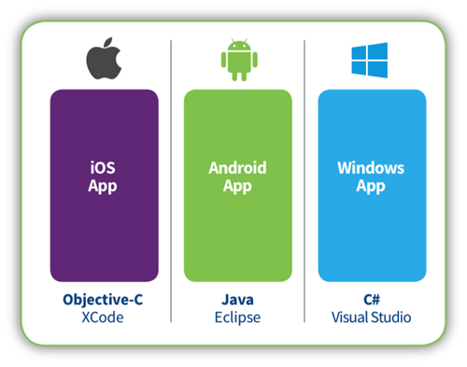
Full Native
Swift
Kotlin
F#? VB? Does it matter?
https://www.bizboard.nl/blog/hybrid-vs-native/

Slide 5

Responsive Website
http://www.aqusagtechnologies.com/what-is-responsive-web-design/

Slide 6
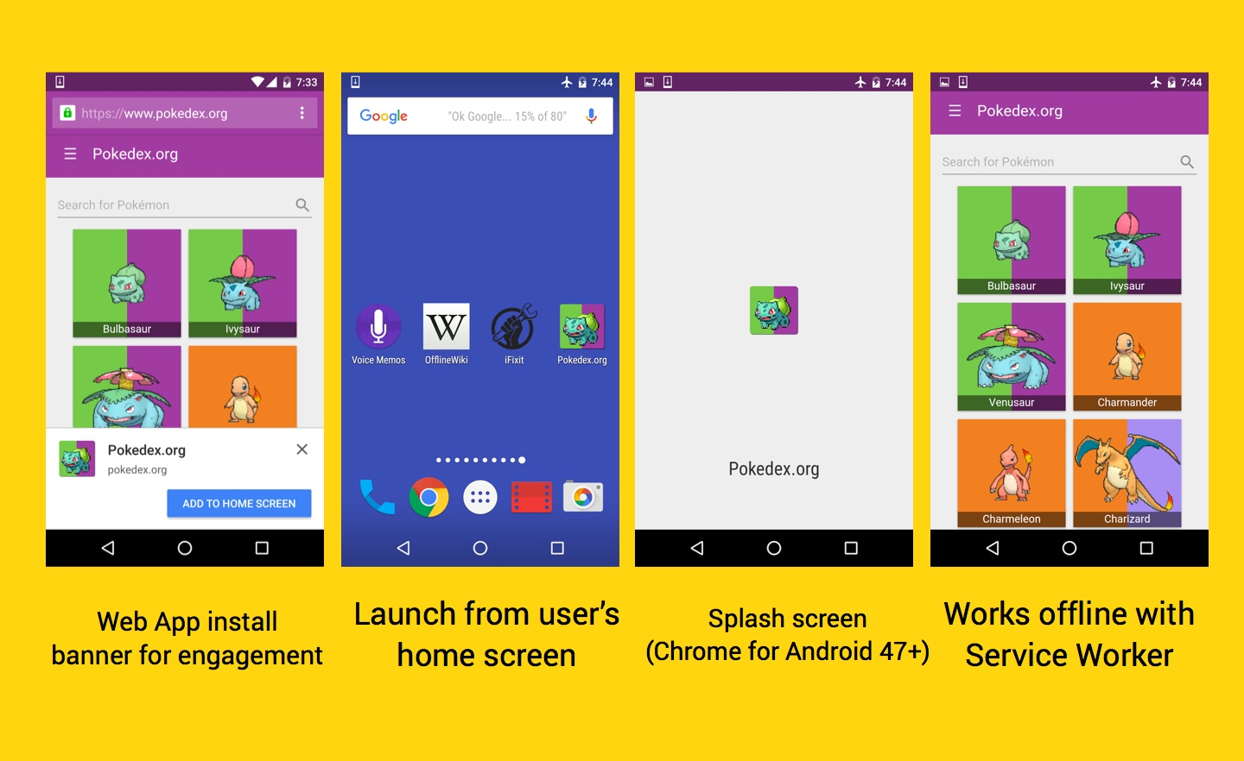
Progressive Web App
https://addyosmani.com/blog/getting-started-with-progressive-web-apps/
Notes:
Beer and tech on service workers is coming soon!

Slide 7
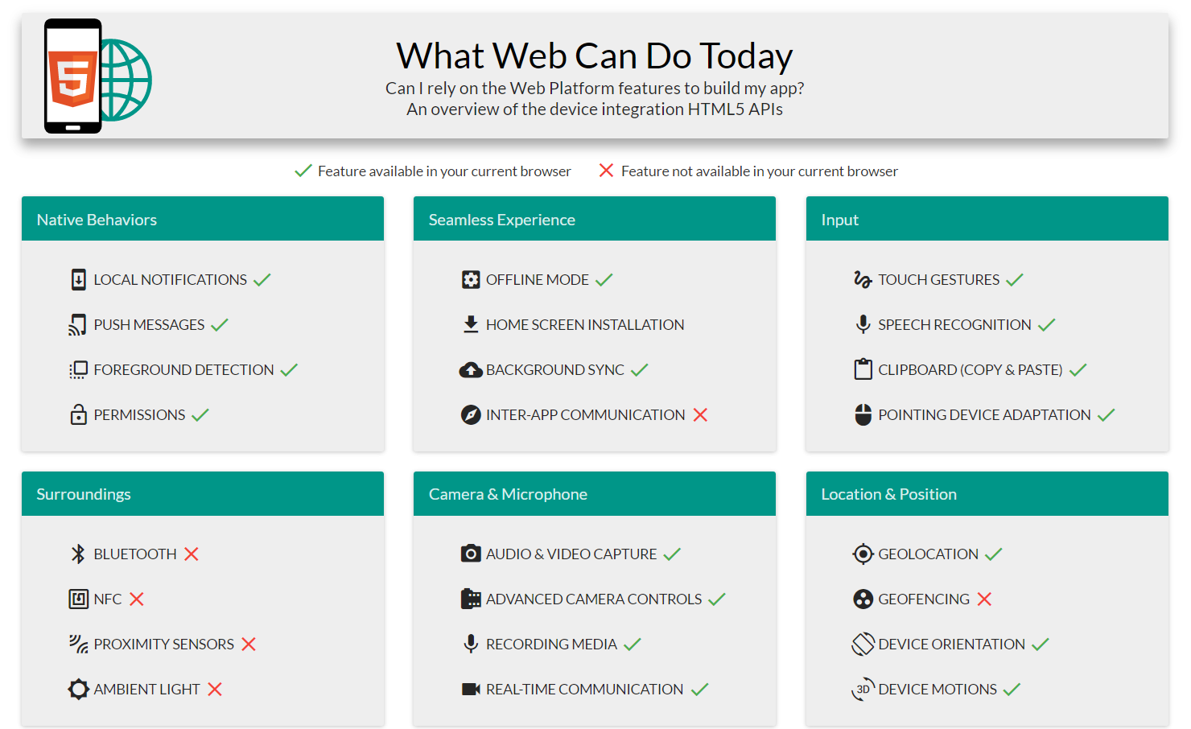
https://whatwebcando.today/

Slide 8





Hybrid

Slide 9
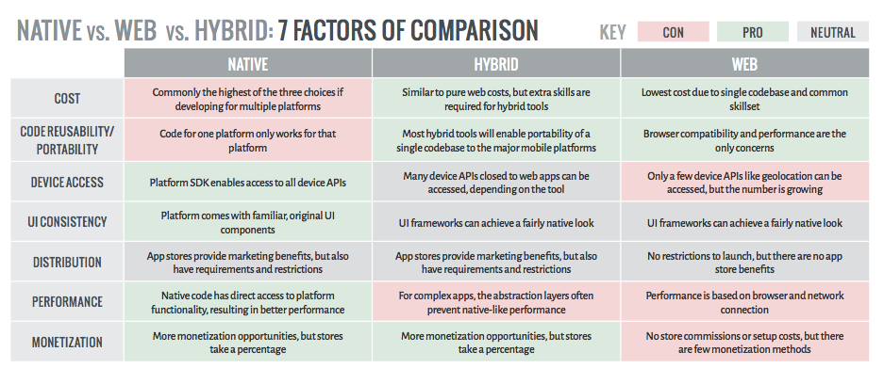
https://dzone.com/articles/state-native-vs-web-vs-hybrid

Slide 10
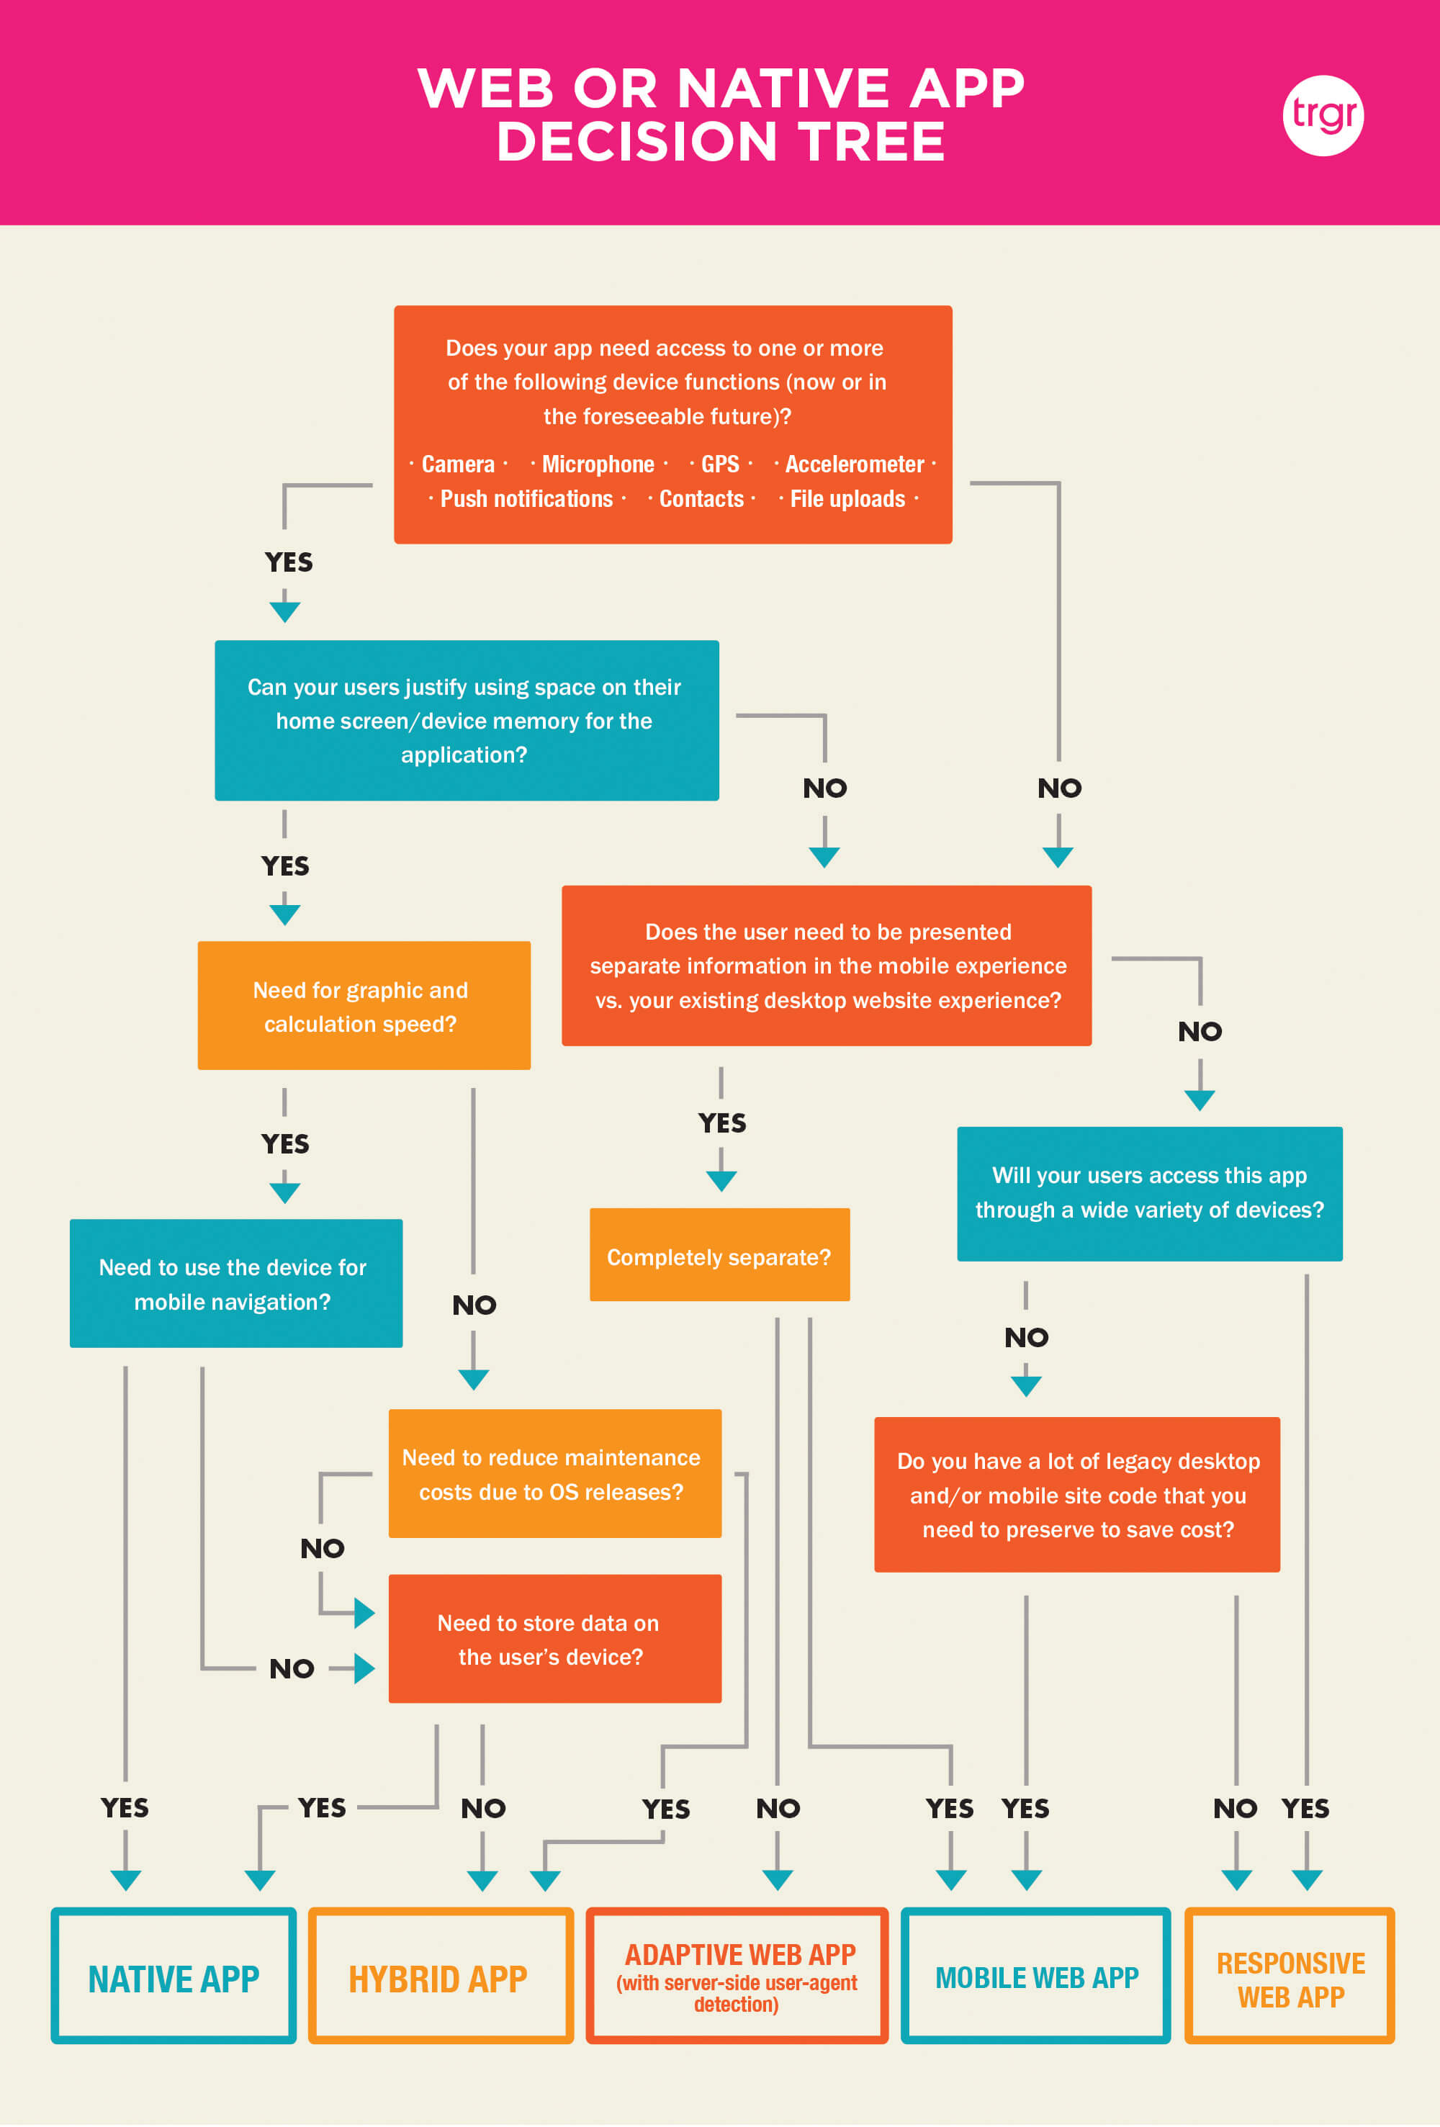
https://trgr.ca/webnativedecisiontreevisual/

Slide 11


Webview based apps
Slow : 1 thread doing all the work, includes logic, animations, transitions, native calls, etc.
Difficult if not impossible to embed native components
Large APK/IPA file due to baggage

Slide 12
Based off angular
Bloated
Heavy usage of TypeScript
I think that JavaScript’s loose typing is one of its best features and that type checking is way overrated. TypeScript adds sweetness, but at a price. It is not a price I am willing to pay.﻿ - Douglas Crockford, author JavaScript: The Good Parts

Slide 13
Was originally expensive, now Free* with VS
C# / F# / VB.Net (ish) transpiled to native code (Fast)
Originally only allowed you to share logic
Share UI with Xamarin Forms
MVVM
https://medium.com/@reicheltp/dev-diary-4-why-i-left-xamarin-behind-35817ccd07b2

Slide 14
Functional Style
No types!!
Team already knew React
Of the 3 PoC’s we did, RN was simplest and most elegant
Hot module reloading
Ability to go native when needed
Same ecosystem as Node/Webdev

Slide 15




JS Environments
Production JavaScriptCore WebKit Ships with iOS bundled with APK
Development Chrome V8
NB! Not running node.js

Slide 16
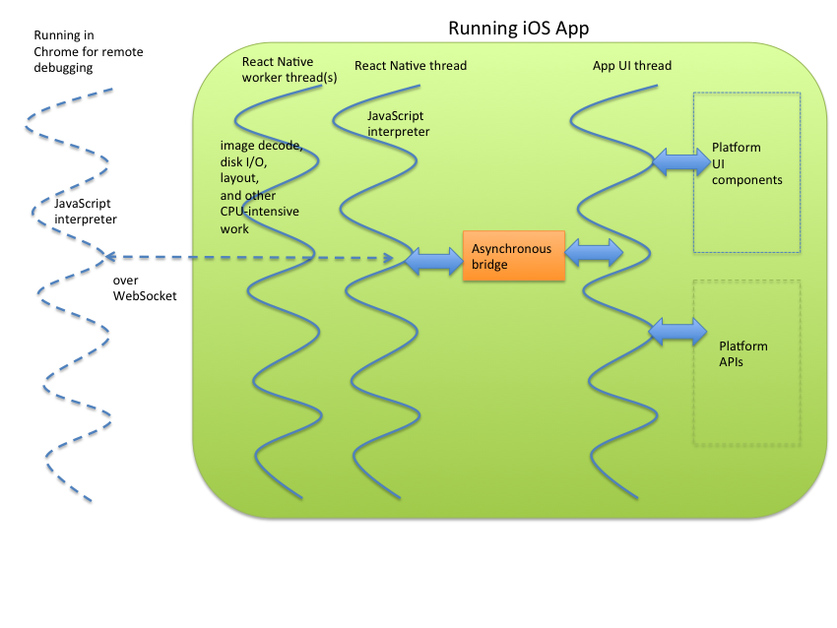
https://www.ibm.com/developerworks/library/mo-bluemix-react-native-ios8/

Slide 17
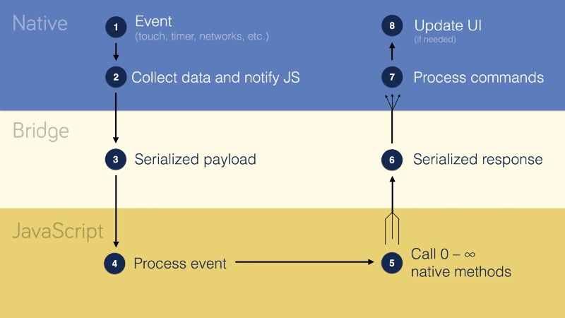
React Native Bridge
Java / Swift / Objective C
C++
JavaScript
https://speakerdeck.com/frantic/react-native-under-the-hood

Slide 18
//option 1 export default class App extends Component { constructor(props) { super(props); this.state = { count: 10 }; } render() { return ( <View> <Text>{this.state.count}</Text> </View> ) } }; //option 2 export function App2({count}) { return ( <View> <Text>{count}</Text> </View> ) } //option 3 export const App3 = count => ( <View> <Text>{count}</Text> </View> );

Slide 19
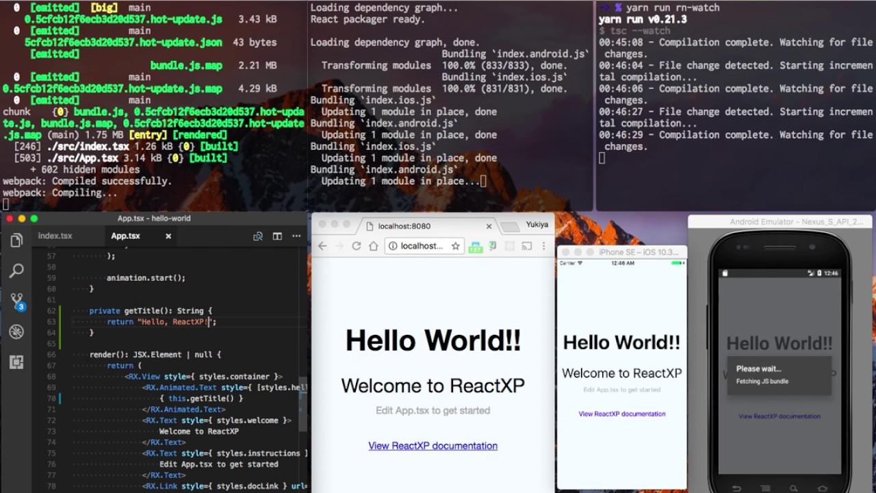
ReactXP
Notes:
ADVANTAGE: Share between the browser and your app.

Slide 20


Slide 21

Demo!

